Slide 1

Exploring Trends and Seasonality in Time Series data
Notes:
Hello everyone,
My name is Ashwini Sharma, and I am from group 4. We are 6 persons in this group.
today we will walk you through our project which we have done in machine learning class.
In this project, we are trying to explore and learn about time series datasets, which have unique characteristics of Trends and seasonality. Followed by a ML model learning the relation and doing forecast on the dataset.

Slide 2

Content
Motivation
Challenges
Time Series Analysis - Concepts
Technical Details
Experimental Results
TSA Libraries used in Industry
Conclusion
Notes:
Presentation is built on these outlines where we are trying to touch upon the project’s motivation, challenges faced, will introduce some important concepts around TSA.
Finally, will discuss the implementation and experimental results with some notes for future work.

Slide 3

Motivation
Time series datasets are set of data points, sequenced over time, and the order in which samples are processed is of vital importance.
Time series data contains trend, seasonal and cyclic components which makes it challenging to capture, train and predict effectively.
Linear Regression models assume the relation between variables to be constant over the time. Time series data may exhibit non-stationarity.
Time series data has many use cases like sales and weather forecasting, change in inflation rate, country-wide GDP, job growth, and financial analysis, which makes it critical for decision-making.
Notes:
Motivation plays a critical role from the inception and in this project our initial motivation was to learn the time-series aspect in the datasets, to do predictions using machine learning techniques.
To understand What and why of this project, defining time series is important.
Data points are sequenced over time in time series and while learning the relation between these points, order of processing is vital.
In general, if relation between dependent and independent variable is constant, ML models can give better predictions.
In contrast, time series not necessarily follow stationarity as different components namely trend, seasonal and cyclic patterns make prediction a unique challenge in itself. We will explain these in detail while introducing the concepts.
Furthermore, learning relation in time series is of real importance as there are multiple use cases around us.
sales forecasting, financial analysis (stock market, GDP, inflation rate) are few examples

Slide 4
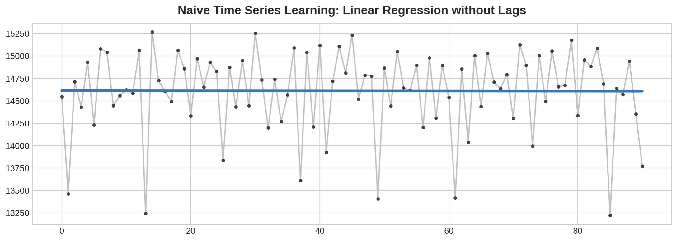
Naïve Learning Problem
Notes:
To understand the challenge in prediction of time series, we tried the naïve linear regression between one independent variable (time, converted to numerical value) and a dependent variable sales over those data points.
Here we wanted to learn the regression line for the sales over time and blue line shows that relation here given by naïve model.
This is the impact of order, trend and seasonality which is making training harder on these data points, resulting in a relation not making much sense for prediction.

Slide 5

Challenges
Finding the dataset with enough observations as well as seasonality component along with trends to train the model.
Checking the stationarity in the time series data. Once found, ways to make the data stationary.
Which statistical model is better to handle the trends as well as seasonality in the data.
Is hyperparameter tuning required?
Notes:
Stationarity Check:
It is important to check as most statistical models support only stationary datasets.
Datasets with constant mean value and constant variance with time-frame -- then it's Stationary
(If a dataset doesn't have Trend, Seasonality, Cyclical, and Irregularity components of the time series, then it's Stationary
If either the mean-variance or covariance (relationship between two variables) is changing with respect to time, the dataset is called non-stationary.

Slide 6
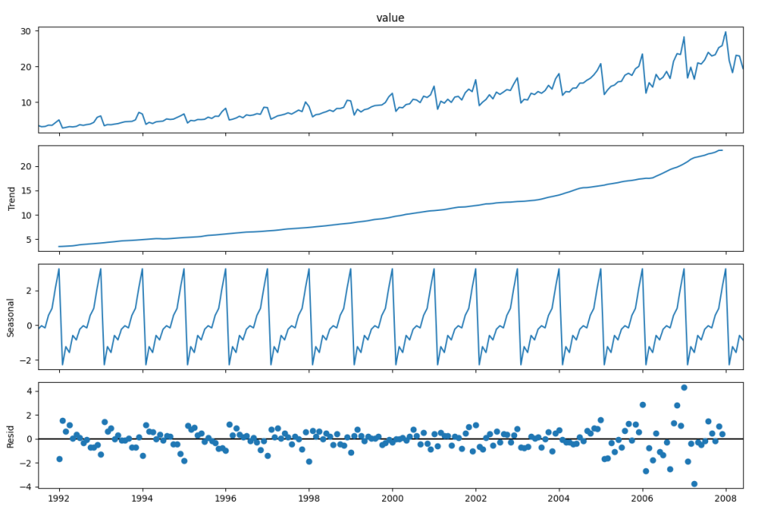
Time Series Analysis Concepts: What
Time Series has four components which are described below:
Trend: There is no fixed time interval. It represents growth or decline in the data over an extended period.
Cycle: It represents repeated patterns or fluctuations in the data.
Seasonality: It represents the pattern repeated at regular intervals.
Irregularity: It captures the unpredictable elements in the time series.
Notes:
→Define
Trend:
Definition: The long-term movement or general direction in the data.
Example: If you observe a consistent increase or decrease in the data over time, it indicates a trend.
Visualization: When you plot the data, the trend component shows the overall upward or downward movement.
Seasonality:
Definition: Regular and predictable variations in the data that occur at specific intervals.
Example: Sales of winter clothing might show a seasonal pattern with higher sales during colder months.
Visualization: A repeating pattern at consistent intervals, such as peaks and troughs, indicates seasonality.
Cycle:
Definition: Longer-term undulating patterns that are not as regular as seasonality.
Example: Economic cycles, which may span several years, can be a form of cycle.
Visualization: Cycles are observed as waves or fluctuations that are not as predictable as seasonality.
Irregular/Residual:
Definition: Unpredictable and random fluctuations in the data that cannot be attributed to trend, seasonality, or cycles.
Example: Unexpected events, like sudden spikes or drops in sales due to external factors.
Visualization: The residual component is what remains after removing the trend, seasonality, and cycle.
→Example
To understand the mentioned components in last slide, we can take this example where sales over the years is projected in first section.
We can clearly understand that sales grew over the years and there is a positive growth trend. While the overall sales is increasing, we can also observe that there are peaks and valleys in some constant time interval, called seasonal impact.
2nd and 3rd section is plotted only for the trend and seasonality of the sales to highlight them clearly.
In simple words, as the population is growing and purchasing power is increasing, sales of toys are growing each year and there is a positive trend,
also we know that during summer and Christmas they sales are at peaks for that year which can be called seasonal impact.
Moreover, every few years, if sales are dropping for a certain period due to GDP or market inflation, that is the cyclic component.

Slide 7
Time Series Analysis Concepts: Why
It is important to check as most statistical models support only stationary datasets.
If a dataset doesn't have Trend, Seasonality, Cyclical, and Irregularity components of the time series, then it's Stationary.
Constant mean value; constant variance with time-frame & If either the mean-variance or covariance (relationship between two variables) is changing with respect to time, the dataset is called non-stationary.
Notes:
A stationary time series is one whose statistical properties, such as mean, variance, and autocorrelation, remain constant over time.
Checking for Stationarity:
Visual Inspection:
Plot the time series data and check for any obvious trends or seasonality.
Look for patterns or cycles that repeat over time.
Summary Statistics:
Split the time series into two or more segments and compare the mean and variance of each segment.
If the mean and variance vary significantly between segments, the series may not be stationary.
Or
Augmented Dickey-Fuller (ADF) Test / KPSS

Slide 8
Time Series Analysis Concepts: How to Check
Different methods were used to test the hypothesis:
KPSS(Kwiatkowski-Phillips-Schmidt-Shin): A statistical test to check the stationarity in time series data for checking the trend in the data. The KPSS test is conducted with the following assumptions.
Null Hypothesis (HO): Series is trend stationary or series has no unit root.
Alternate Hypothesis(HA): Series is non-stationary, or series has a unit root.
ADF(Augmented Dickey-Fuller) : It is also a statistical test to check the stationarity of the time series data by checking unit root. ADF test is conducted with the following assumptions:
Null Hypothesis (HO): Series is non-stationary, or series has a unit root.
Alternate Hypothesis(HA): Series is stationary, or series has no unit root.
Note: The hypothesis is reversed in the KPSS test compared to ADF Test.
A unit root is a characteristic of a time series variable that indicates it has a stochastic or random trend. In simpler terms, a variable with a unit root is unpredictable and does not revert to a stable mean over time.
Notes:
KPSS:
Conditions to Fail to Reject Null Hypothesis(HO)
If the Test Statistic < Critical Value and p-value < 0.05 – Fail to Reject Null Hypothesis(HO), i.e., time series does not have a unit root, meaning it is trend stationary. p > .05 -- failed to reject null hypothesis --which means, it is trend stationary
ADF:
Conditions to Fail to Reject Null Hypothesis(HO)
If Test statistic < Critical Value and p-value < 0.05 – Reject Null Hypothesis(HO), i.e., time series does not have a unit root, meaning it is stationary. It does not have a time-dependent structure. non-stationary p > alpha 0.05 -- failed to reject null hypothesis

Slide 9
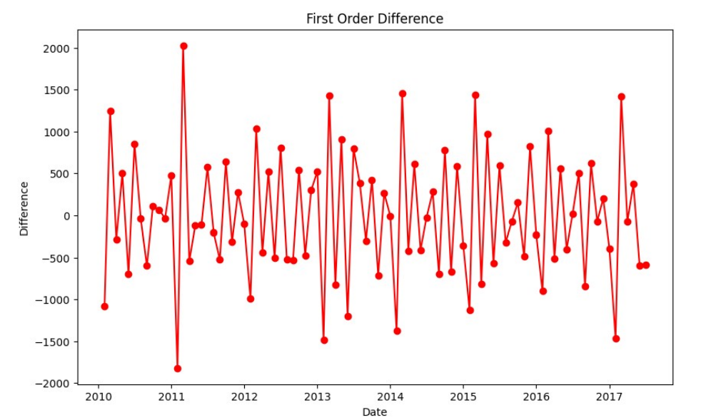
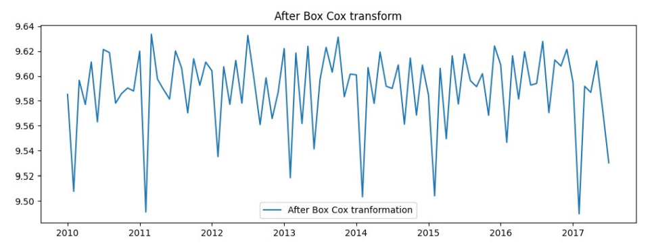
Time Series Analysis Concepts: How to Transform
To use models for predictions, we should do the below things:
• Differencing: Transform the data by computing difference between consecutive observations (can be repeated, d-orders)
• Transformation (log, BoxCox): It is common preprocessing step in time series analysis to transform non-stationary data into stationarity data (stabilize variance).
Notes:
Differencing:
Compute the difference between consecutive observations (first-order differencing).
Repeat differencing if necessary until the series becomes stationary.
The order of differencing is denoted as �d in ARIMA models.
Log Transformation:
Apply a logarithmic transformation to stabilize variance in the presence of changing variance over time.
Log: Stabilizing variance in the presence of exponential growth or decay.
BoxCox: Similar to log transformation but more general as it can handle zero and negative values. Stabilizing variance and achieving normality.
Seasonal Differencing:
For time series with seasonality, take the difference between observations at a fixed lag corresponding to the season's length.
Detrending:
Remove a trend component from the time series.
This can be done by fitting a regression model to the data and using the residuals as the detrended series.

Slide 10
Technical Details: Statistical Model
AR(Auto-Regressive): It will be addressing autocorrelation by taking into the account the relationship between observation and lagged observations.
MA(Moving Average): It will be performed by taking out fluctuations and focusing on trend over a specific period. It is calculated by taking average of all data points in given period.
ARMA(Auto-Regressive Moving Average) : It is useful when a time series exhibits both autoregressive and moving average behavior. It involves using statistical methods to fit the model to the observed time series data. This can be done using techniques such as maximum likelihood estimation.
ARIMA(Auto-Regressive Integrated Moving Average): Used to forecast the future value of univariate time series data.
SARIMA(Seasonal Auto-Regressive Integrated Moving Average): To capture both seasonal and non-seasonal components in data using period parameter.
Notes:
AR:
Focuses on the relationship with past observations, capturing trends and long-term dependencies
The AR model focuses on capturing the relationship between a current observation and its past values (lagged observations).
It assumes that the current value of the time series is a linear combination of its own past values.
It is suitable when the past values of a time series are expected to have a lasting effect on its future values.
MA:
Focuses on the relationship with past white noise terms, capturing short-term fluctuations and random shocks.
emphasizes the relationship between a current observation and a white noise term (a moving average of past white noise terms).
It assumes that the current value is a linear combination of past white noise terms.
This model represents the relationship between an observation and a residual error from a moving average process applied to lagged observations.
It is suitable when the time series exhibits short-term dependencies between consecutive observations.
ARMA:
The combination of both AR and MA components in ARMA models allows for a more comprehensive modelling approach, capturing both short-term and long-term dependencies in the data.
ARIMA:
ARIMA is an extension of ARMA that includes differencing to make the time series stationary
The notation for an ARIMA model is ARIMA(p, d, q), where d is the degree of differencing needed to make the series stationary
SARIMA:
SARIMA extends ARIMA to include seasonality in the time series data
The notation for a seasonal ARIMA model is SARIMA(p, d, q)(P, D, Q, s), where P, D, and Q are similar to p, d, and q, but for the seasonal component, and s is the length of the season
When to use each model:
AR Model (AR): Use when there is a clear trend or pattern in the past values that is expected to continue into the future.
MA Model (MA): Use when there are short-term dependencies in the data, and the current value is dependent on recent error terms.
ARMA Model (ARMA): Use when there is a combination of both short-term and long-term dependencies in the data.
ARIMA Model (ARIMA): Use when the time series is non-stationary and requires differencing to make it stationary.
SARIMA Model (SARIMA): Use when there is a seasonal component in the data along with non-stationarity.
------
Detrending or Differencing: We make the data stationary by using differencing. Differencing is a technique in which we compute the difference between consecutive observations and then we create differenced series by subtracting previous value from the current value until we get the stationarity in data. or by removing the trend from the data using different techniques like by taking log.
Auto-Regressive: It addresses the correlation among data points by considering the relationship between observation and lagged observation.
MA(Moving Average): As the name suggests, in it we calculate the average of all data points for a specific period and focus on trends by removing the fluctuations.
Seasonal Decomposition: In this we decompose data into all the components like trends components, seasonal components, and other components by using different STL techniques.

Slide 11
Experimental results: With Random Values
Model | RMSE | MAE
AR | 692.151 | 534.061
MA | 740.450 | 597.118
ARMA | 743.016 | 648.108
ARIMA | 741.809 | 599.068
SARIMA | 431.838 | 333.449
Notes:
Global sales dataset for 8 years ranging from 2010 – 2017; aggregated monthly; total points 91, train 79 and test 12

Slide 12
Experimental results: Hyperparameter Tuning using auto_arima from pmdarima library
ARIMA | Before Tuning | After Tuning
RMSE | 741.809 | 692.151
MAE | 599.068 | 534.061
SARIMA | Before Tuning | After Tuning
RMSE | 431.838 | 412.061
MAE | 333.449 | 320.800
Notes:
Best Parameters
ARIMA: (4,0,0)
SARIMA: (1,0,1)(0,1,1)[12]
That clearly indicates that data has seasonal component as SARIMA is producing much better results.

Slide 13

TSA Libraries used in Industry
TBATS (Trigonometric seasonality, Box-Cox transformation, ARMA errors, Trend, and Seasonal components): It is a time series forecasting method which deals with multiple seasonality and complex patterns.
We give raw data and visual inspection; stationarity testing and transformation is not required, and we get this output.
Model Summary:
Use Box-Cox: True , Use trend: False , Use damped trend: False ,Seasonal periods: [12.],
Seasonal harmonics [5] , ARMA errors (p, q): (1, 1) , Box-Cox Lambda 1.000000 , Smoothing (Alpha): 0.010317
FB Prophet: It is an open-source tool which is developed by Facebook for forecasting the time series data. It is designed to handle daily observations. Predict future points using raw data with confidence interval
Notes:
We give raw data and visual inspection, stationarity testing and transformation is not required and we get this output.
Model Summary:
Use Box-Cox: True
Use trend: False
Use damped trend: False
Seasonal periods: [12.]
Seasonal harmonics [5]
ARMA errors (p, q): (1, 1)
Box-Cox Lambda 1.000000
Smoothing (Alpha): 0.010317
FB : Predict future points using raw data with confidence interval, we can also introduce calendar with holidays to capture sudden spikes in sales due to specific day
The Box-Cox transformation is a power transformation that is applied to stabilize the variance and make a dataset more closely approximate a normal distribution. λ is the transformation parameter

Slide 14
Conclusion
After running both ARIMA and SARIMA using the best hyperparameters (from tuning) we can conclude that SARIMA produced better results as seasonal component is present in our dataset (annual frequency).
The results from evaluation metrics, RMSE and MAE both produce a lower error for SARIMA, mentioned below:
ARIMA
RMSE: 692.151
MAE: 534.061
SARIMA
RMSE: 412.061
MAE: 320.800

